Slide 1

Prince Vuyani Nyangasya ST10458337
Purpose: A weather app that displays the average week temperature and more details

Slide 2
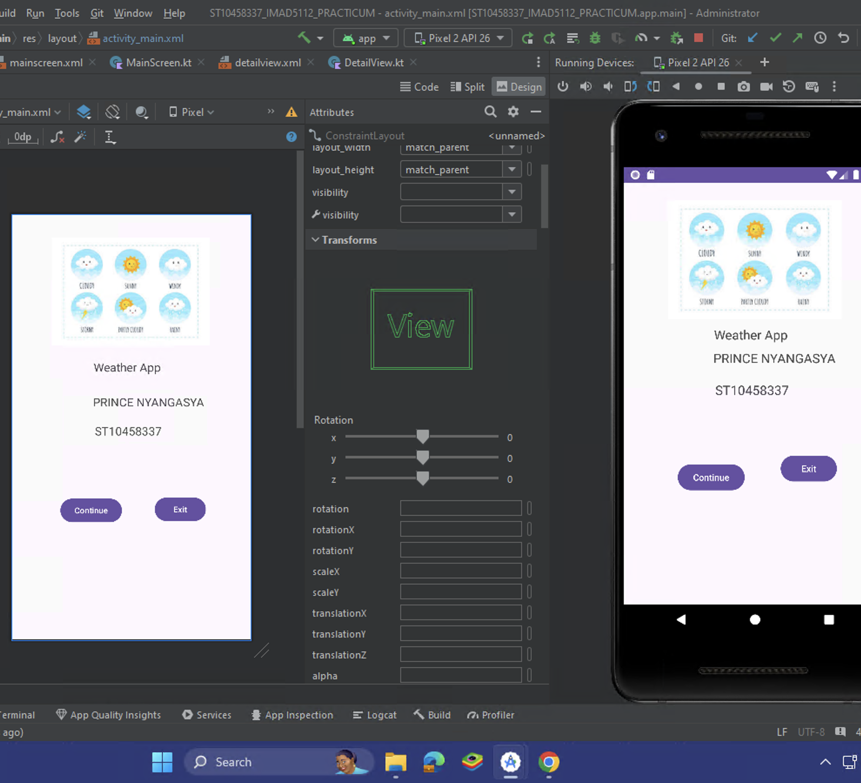
Splash screen
Introduction screen for logo, title, student name/number, continue button and exit button

Slide 3
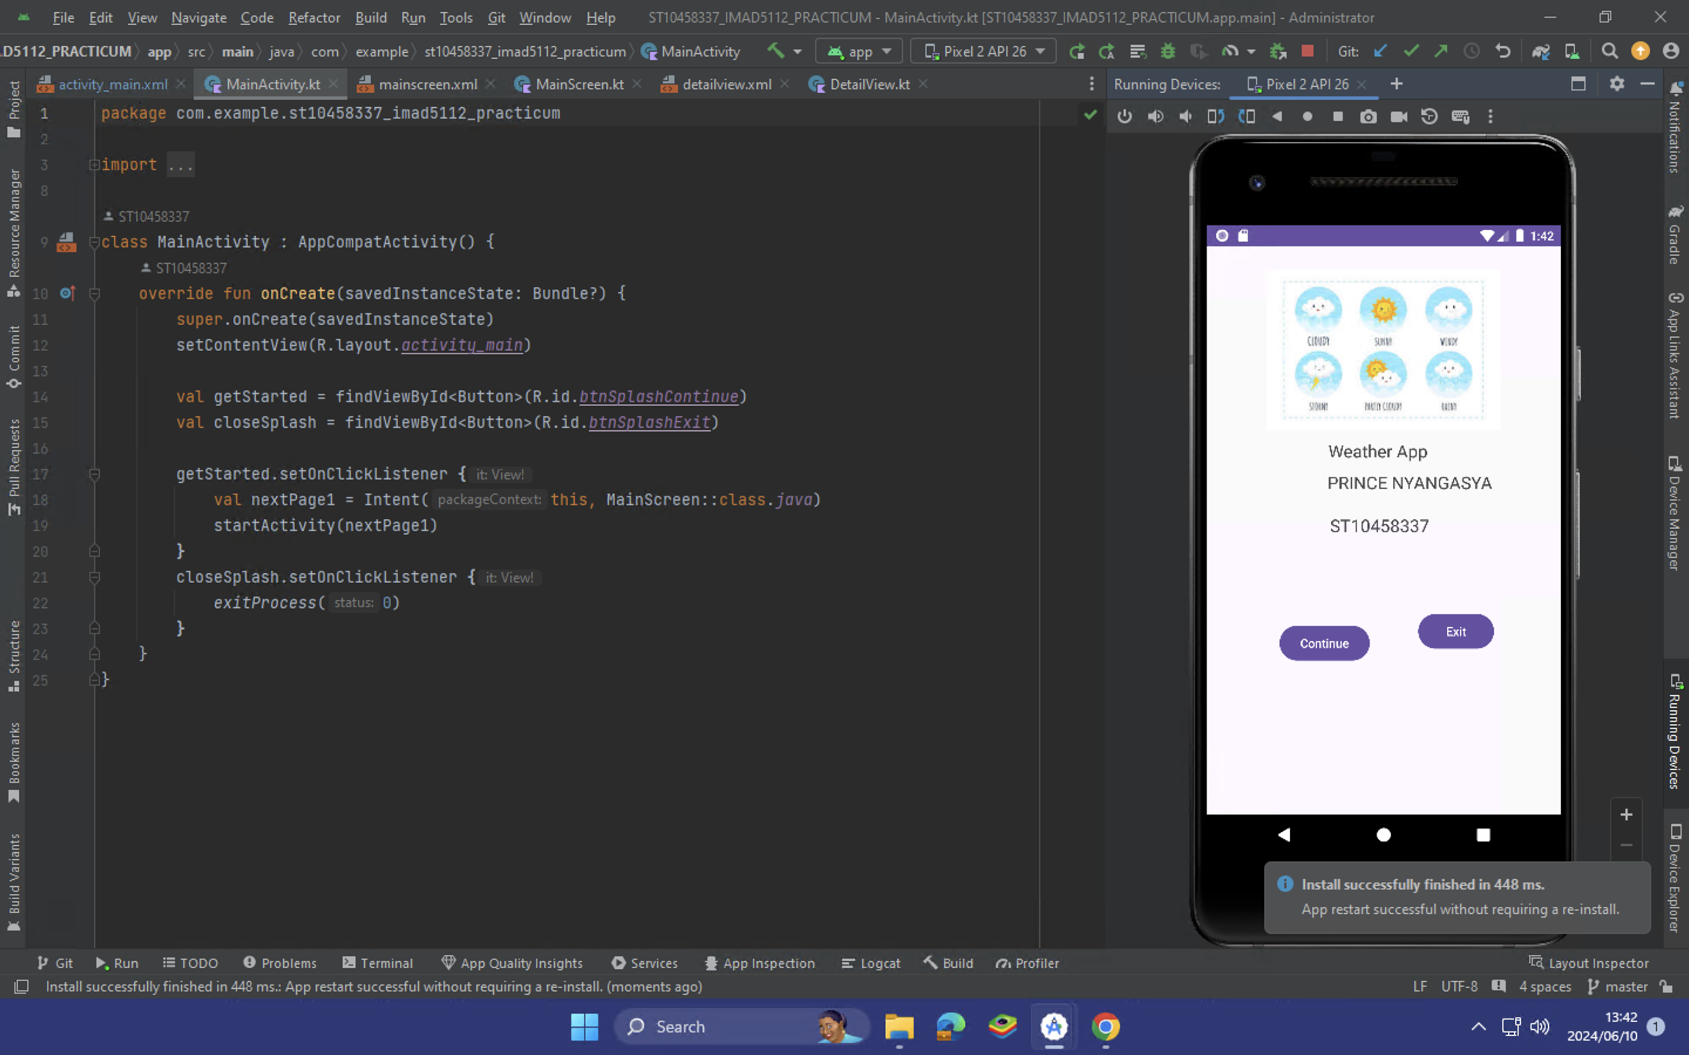
CODE FOR SPLASH SCREEN
User will be taken to the next screen

Slide 4
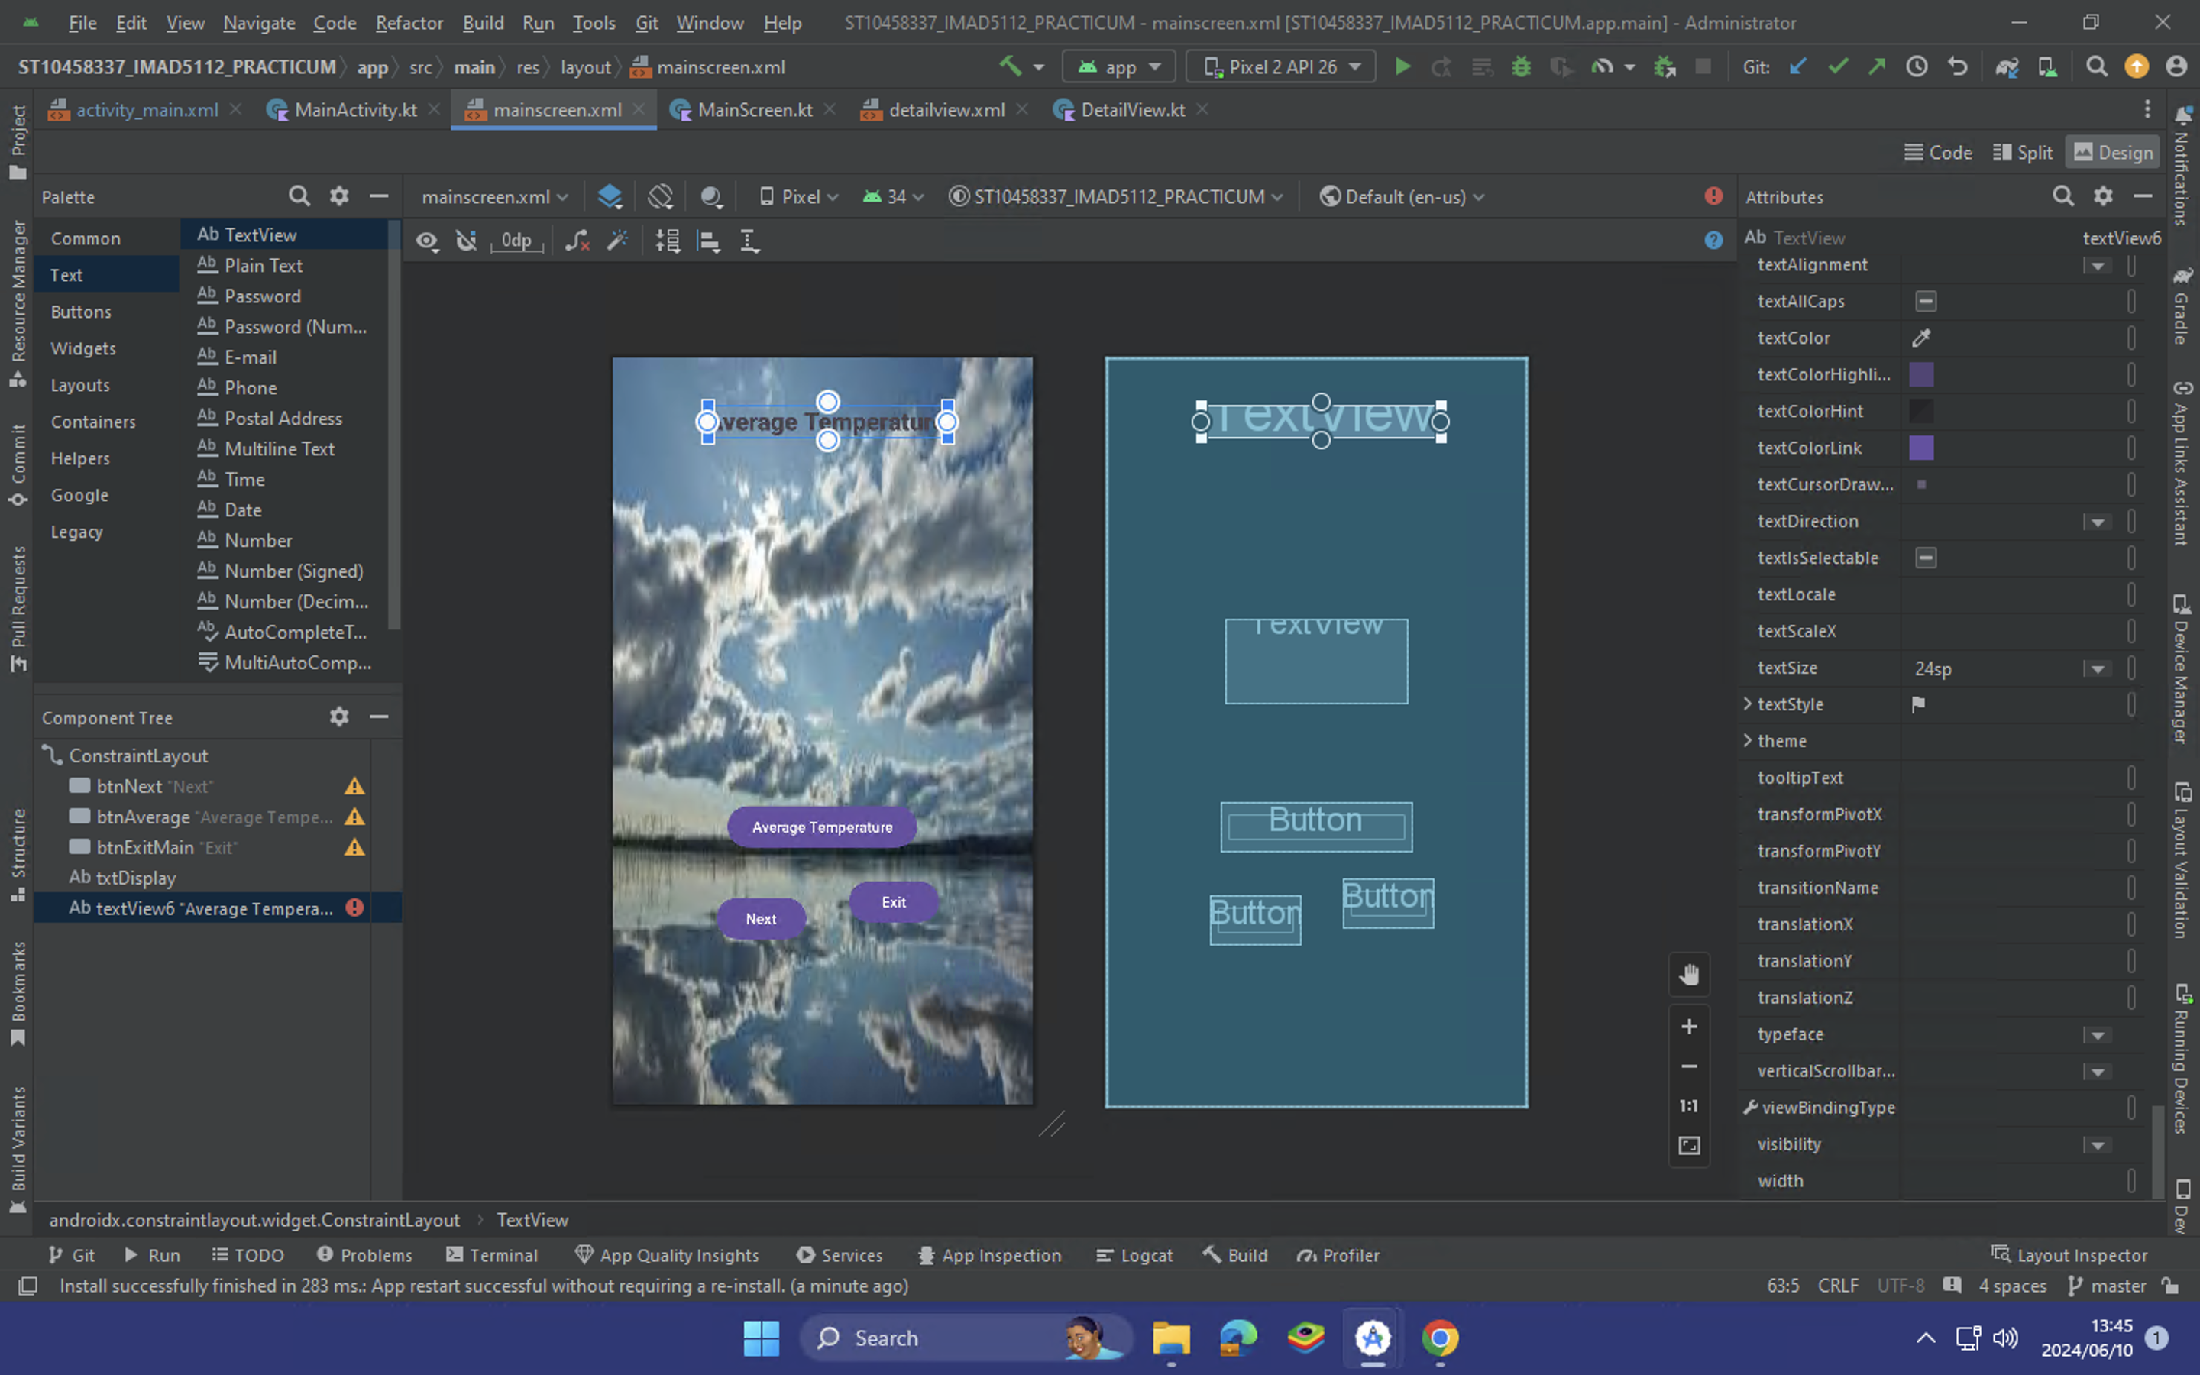
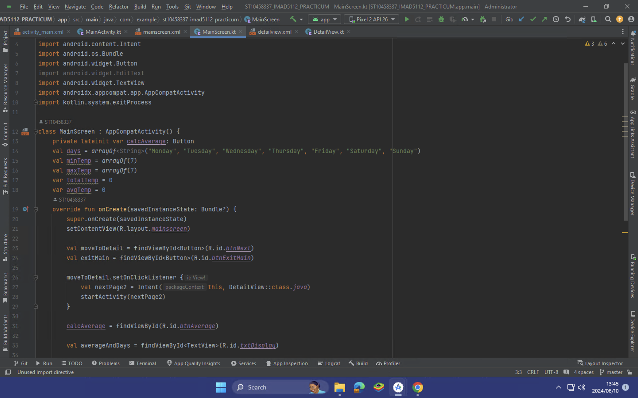
Main screen and code

Slide 5
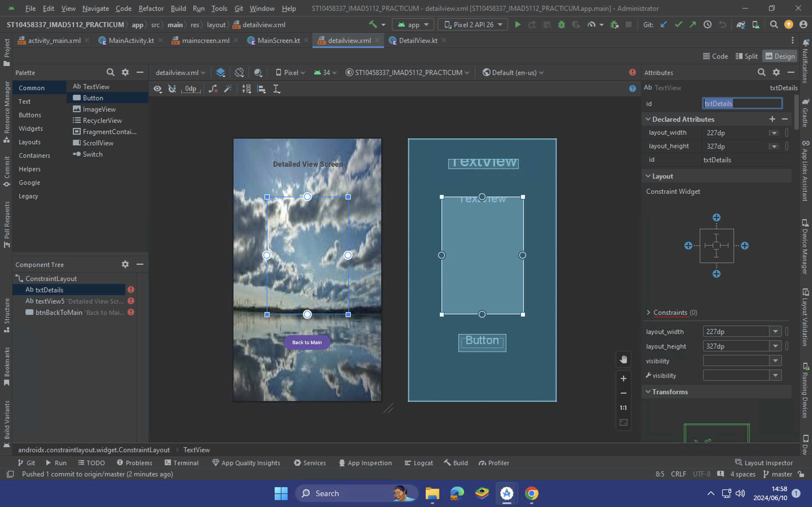
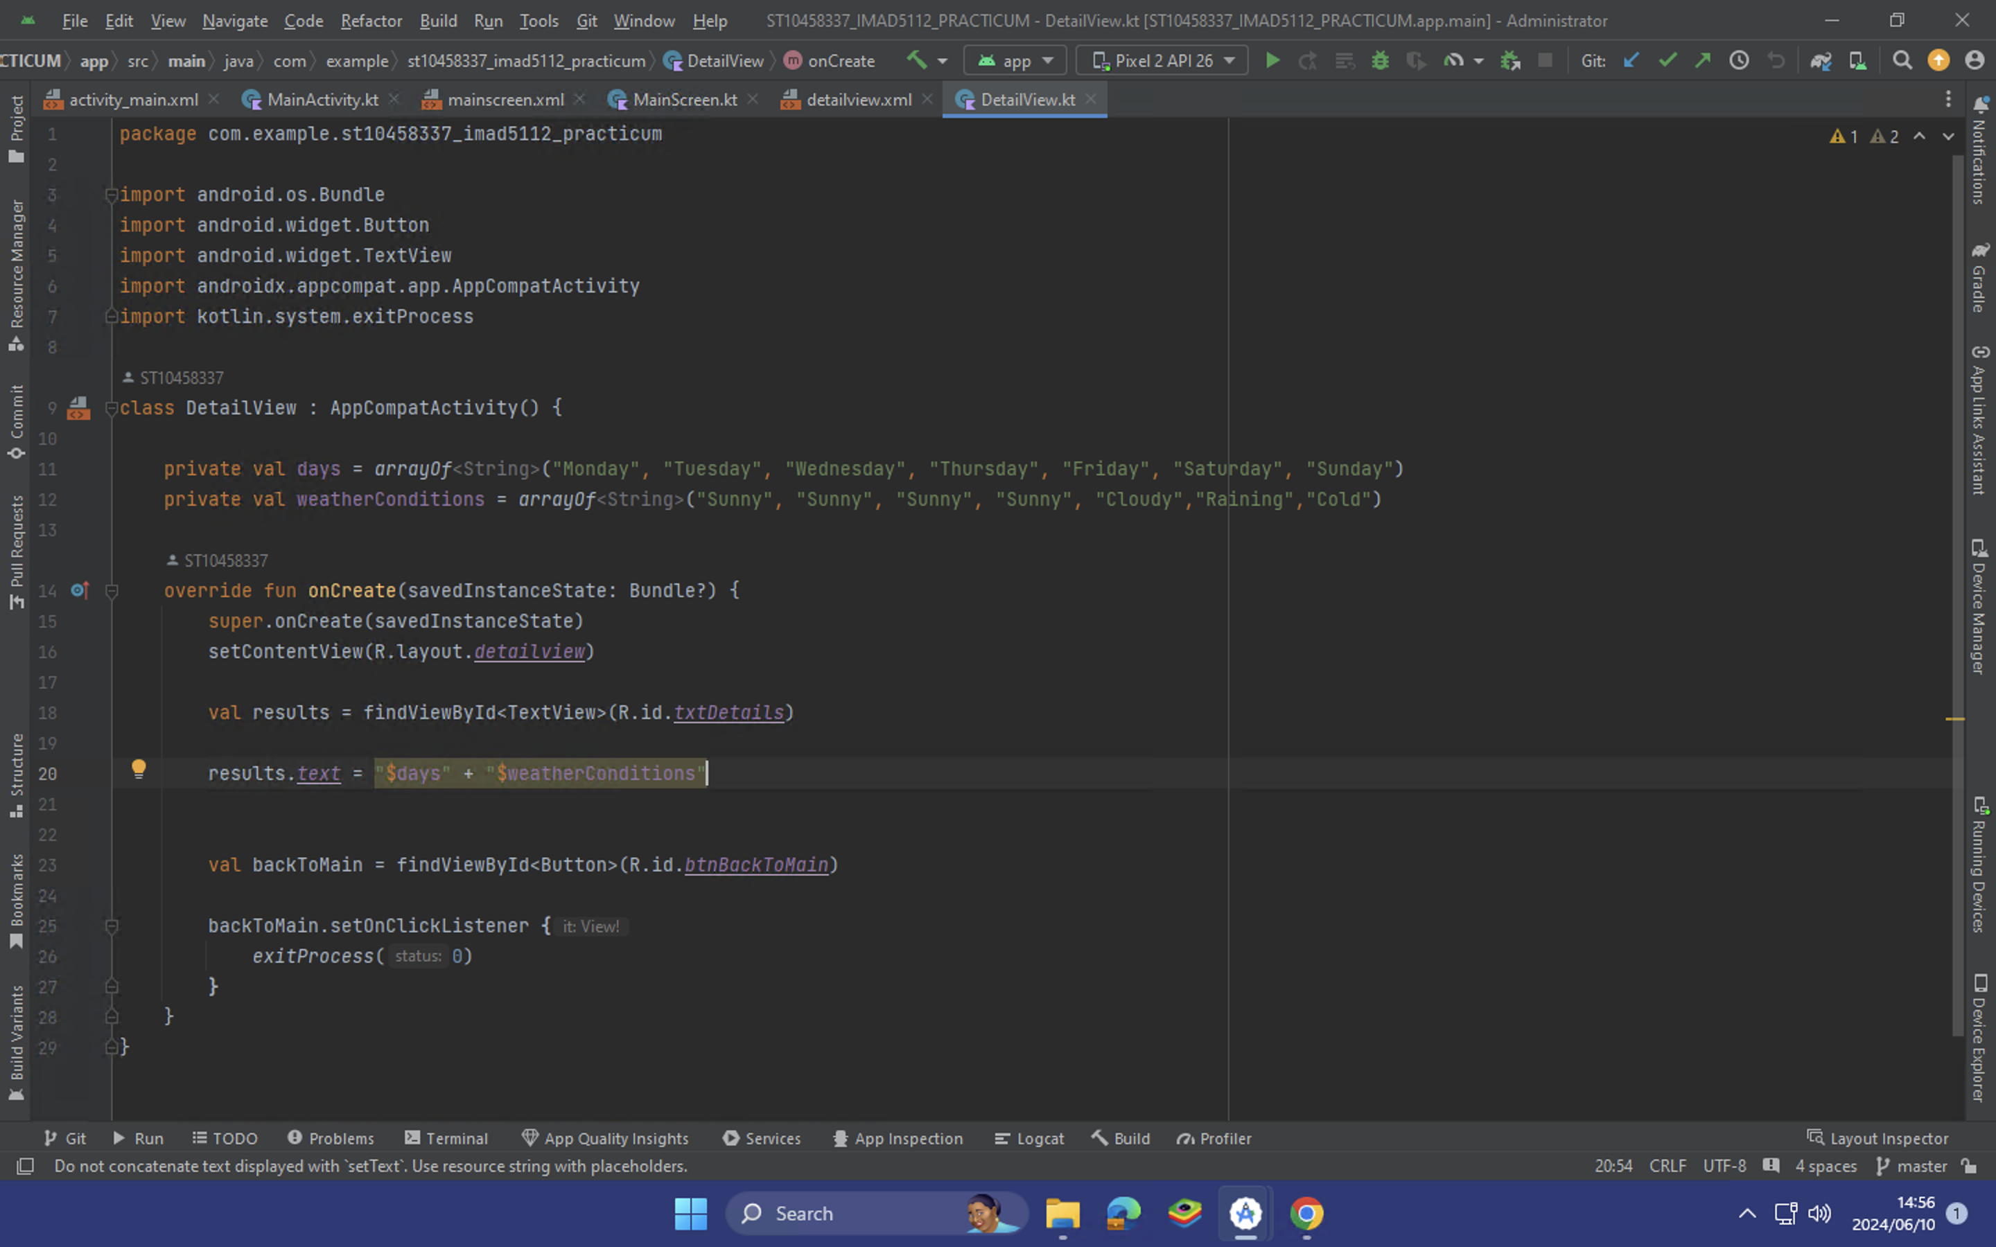
Detailed view screen and code

